Slide 1
How to Summarize an Article
Dirk Riehle, Univ. Erlangen
NYT A02
Licensed under CC BY 4.0 International

Slide 2
Agenda
Summary purpose
Structured analysis
Written Summary

Slide 3
1. Summary Purpose

Slide 4
Purpose of Summary Exercises
Analysing and summarizing are crucial skills (for any job)
Analysis
Reading: Absorb the text
Extracting: Extract information
Synthesizing: Gain understanding
Summary
Summarizing: Explain to others

Slide 5
2. Structured Analysis

Slide 6
Structured Analysis Process
Step 1: Extract notes
Read and markup text
Annotate (“code”) marked text
Step 2: Synthesize insights
Synthesize concepts
Sift and sort into categories
Will reappear as qualitative data analysis

Slide 7
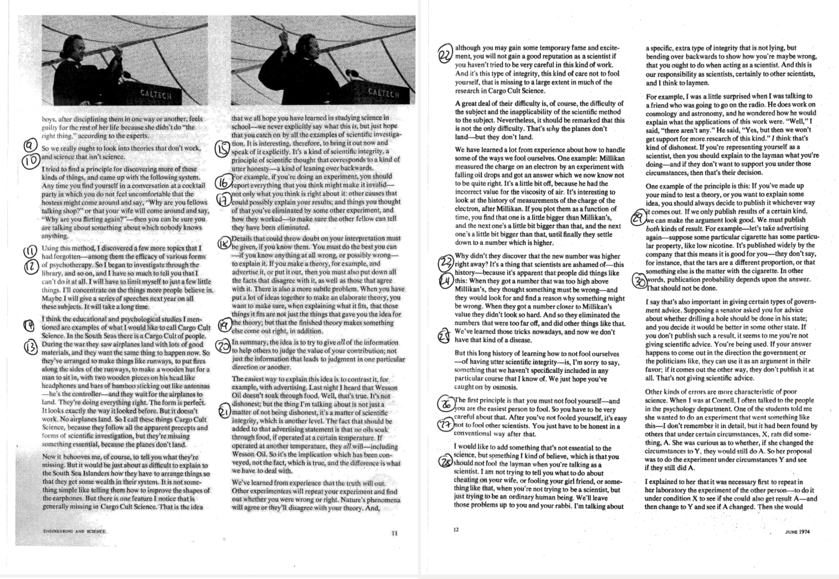
Step 1.a: Markup Text

Slide 8
Step 1.b: Annotate Text
Historically, out of crazy ideas, science
Method of science: eliminate crazy ideas
Crazy unscientific ideas are still alive
Apparently, people like crazy ideas
Why do people cling to crazy ideas?
We believe in not-obviously crazy ideas as well, despite them not working
Examples are today's methods of teaching, ways of treating criminals
Sometimes good commonsense ideas are overruled by “science”
The main measure of theory is: “does it work?”
If a theory does not work, it is not science
Pseudoscience is nonsense that pretends to be science
There is a lot of pseudoscience in psychology and education
The cargo cult is an example of a people going through the motions without understanding
Cargo cult science is pseudoscience---assumed science without understanding
Cargo cult science lacks integrity, a key ingredient of science
Integrity in science means reporting everything about an experiment
In particular if the information invalidates an experiment
When describing a theory, provide all facts you know, for and against it
Hallmark of a theory is that it predicts something in addition to know facts
When doing science, empower others to properly judge your work
Scientific integrity is more than just being honest; list all facts, cover all contexts
Your reputation as a scientist depends on continued displayed integrity
Scientists after Millikan were consciously or subconsciously anchored by his results
Scientists manipulated results to conform with assumed truth
Science is a social endeavor
First principle of scientific integrity: Don't fool yourself
Second principle of scientific integrity: Don't fool others
Also, don't lie to non-experts; treat them with the same integrity as other scientists
Publish all your findings; those matching your theory and those which don't
Do not be swayed by inconvenient results; remain honest and publish anyway
Repeating experiments is necessary to build on them properly
It is not of integrity to skip repeating experiments just because you don't get time/money/publications for it
Pay attention to method, build understanding, don't run on assumptions
A key property of science is that experiments are repeatable

Slide 9
Step 2.a: Synthesize Concepts
Crazy ideas historically
Historically, out of crazy ideas, science
The method of science: eliminate crazy ideas
Crazy ideas today
Crazy unscientific ideas are still alive
Apparently, people like crazy ideas
Why do people cling to crazy ideas?
We believe in not-obviously crazy ideas as well, despite them not working
Examples are methods of teaching, decreasing crime by treating criminals
Pseudoscience as one form of today's crazy ideas
Sometimes good commonsense ideas are overruled by „science“
Pseudoscience is nonsense that pretends to be science
There is a lot of pseudoscience in psychology and education
The cargo cult is an example of a people going through the motions without understanding
Cargo cult science is pseudoscience---assumed science without understanding
Main criteria that define good science
The main measure of theory is: “does it work?”
If a theory does not work, it is not science
Cargo cult science lacks integrity, a key ingredient of science
When describing a theory, provide all facts you know, for and against it
Hallmark of a theory is that it predicts something in addition to know facts
When doing science, empower others to properly judge your work
Scientific integrity is more than just being honest; list all facts, cover all contexts
Your reputation as a scientist depends on continued displayed integrity
Publish all your findings; those matching your theory and those which don't
Do not be swayed by inconvenient results; remain honest and publish anyway
Experiments as a key method of science
Integrity in science means reporting everything about an experiment
In particular if the information invalidates an experiment
Scientists after Millikan were consciously or subconsciously anchored by his results
Scientists manipulated results to conform with assumed truth
Repeating experiments is necessary to build on them properly
It is not of integrity to not repeat experiments because you don't get time/money/publications for it
Pay attention to method, build understanding, don't run on assumptions
A key property of science is that experiments are repeatable
Integrity in science
First principle of scientific integrity: Don't fool yourself
Second principle of scientific integrity: Don't fool others
Also, don't lie to non-experts; treat them with the same integrity as other scientists
Science is a social endeavor

Slide 10
Step 2.b: Sort Into Categories
Crazy ideas
Crazy ideas historically
Historically, out of crazy ideas, science
The method of science: eliminate crazy ideas
Crazy ideas today
Crazy unscientific ideas are still alive
Apparently, people like crazy ideas
Why do people cling to crazy ideas?
We believe in not-obviously crazy ideas as well, despite them not working
Examples are methods of teaching, decreasing crime by treating criminals
Pseudoscience
Pseudoscience as one form of today's crazy ideas
Sometimes good commonsense ideas are overruled by „science“
Pseudoscience is nonsense that pretends to be science
There is a lot of pseudoscience in psychology and education
The cargo cult is an example of a people going through the motions without understanding
Cargo cult science is pseudoscience---assumed science without understanding
Good science
Main criteria that define good science
The main measure of theory is: “does it work?”
If a theory does not work, it is not science
Cargo cult science lacks integrity, a key ingredient of science
When describing a theory, provide all facts you know, for and against it
Hallmark of a theory is that it predicts something in addition to know facts
When doing science, empower others to properly judge your work
Scientific integrity is more than just being honest; list all facts, cover all contexts
Your reputation as a scientist depends on continued displayed integrity
Publish all your findings; those matching your theory and those which don't
Do not be swayed by inconvenient results; remain honest and publish anyway
Experiments as a key method of science
Integrity in science means reporting everything about an experiment
In particular if the information invalidates an experiment
Scientists after Millikan were consciously or subconsciously anchored by his results
Scientists manipulated results to conform with assumed truth
Repeating experiments is necessary to build on them properly
It is not of integrity to not repeat experiments because you don't get time/money/publications for it
Pay attention to method, build understanding, don't run on assumptions
A key property of science is that experiments are repeatable
Integrity in science
First principle of scientific integrity: Don't fool yourself
Second principle of scientific integrity: Don't fool others
Also, don't lie to non-experts; treat them with the same integrity as other scientists
Science is a social endeavor

Slide 11
3. Written Summary

Slide 12
Written Summary Process
Step 3: Outline summary
Identify key insights
Bring insights into proper order
Step 4: Write summary
Decide on framing
Expand insights into summary

Slide 13
Step 3.a: Identify Key Insights
Crazy ideas always existed; they gave birth to modern science and the scientific method as a counteraction
Pseudoscience is modern form of crazy ideas; differs from real science by lack of integrity, does not follow scientific method
Proper science uses proper methods, specifically experiments; experimenters need to be of full integrity; report everything; don't fool yourself, don't fool others.
Science is a social endeavor; will be difficult even in the future not to fool ourselves; expect failures to continue; keep striving

Slide 14
Step 3.b: Bring Insights Into Proper Order
Crazy ideas always existed; they gave birth to modern science and the scientific method as a counteraction
Proper science uses proper methods, specifically experiments; experimenters need to be of full integrity; report everything; don't fool yourself, don't fool others.
Pseudoscience is modern form of crazy ideas; differs from real science by lack of integrity, does not follow scientific method
Science is a social endeavor; will be difficult even in the future not to fool ourselves; expect failures to continue; keep striving

Slide 15
Step 4.a: Decide on Framing
Add introduction (optional)
Decide on conclusion

Slide 16
Step 4b: Expand Insights Into Summary
In his Caltech 1974 commencement speech, physics Nobel prize laureate Richard Feynman addresses the graduates on the topic of science and scientific integrity. He discusses crazy ideas, pseudoscience and real science, and the method of science, with the purpose of admonishing graduates to live a life of scientific integrity.
Before science, there were “crazy ideas” (Feynman's words), that is theories about the world that had no scientific basis. A reason is that the scientific method did not yet exist. However, out of crazy ideas not working, men invented the scientific method, which is the process of elimination of ideas not working until only ideas (or theories) remain which we have not yet been proved wrong.
Science then is the human endeavor of discovering the truth by way of appropriate methods, specifically experiments. In experiments, scientists try to answer a question by enacting the effect they have a question about. They do so by trying out all possible variations and circumstances of context that affect the answer to their question, until they can clearly identify a relationship between those circumstances and the observed effects. Science is a process with many unknowns, so it is of utmost importance that the scientist be of highest integrity, which specifically means that he or she report about everything they observe, whether it supports their answers to their question or not.
Despite science and the invention of the scientific method, crazy ideas still exist today in the form of “pseudoscience”. Feynman also calls pseudoscience “cargo cult science”, based on the cargo cult of a people of the South Seas. That people had once experienced superior American technology, which had done them well. When the Americans left, they tried to recreate it by simulating landing airplanes in the form of wooden replicas. Pseudoscience is like the cargo cult: It goes through the motions without proper understanding. It fails to setup the necessary requisites, In short, it does not apply the scientific method properly and lacks integrity.
There are many ways in how honest scientists can fail to apply the scientific method properly. Social pressure is one reason. Science is a social endeavor and we must be aware that what we consider truth today may actually be false, not only because we overlooked something technical or made a mistake, but also because the social context of science leads us to wrong conclusions and to fool ourselves and others. Thus, science or the search for truth is a never ending process.

Slide 17
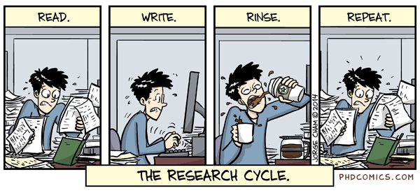
The Research Cycle [1]
[1] See https://phdcomics.com

Slide 18
Summary
Summary purpose
Structured analysis
Written Summary

Slide 19
Thank you! Any questions?
dirk.riehle@fau.de – https://oss.cs.fau.de
dirk@riehle.org – https://dirkriehle.com – @dirkriehle

Slide 20
Legal Notices
License
Licensed under the CC BY 4.0 International license
Copyright
© 2012, 2023 Dirk Riehle, some rights reserved

